Slide 1
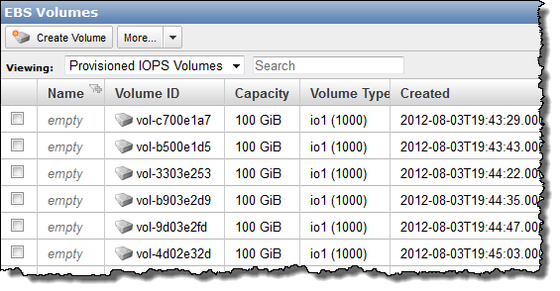
You know all those volumes we have in AWS? I need all them backed up…NOW!

Slide 2


Slide 3
Tips for Automating AWS with Python and Boto
Snakes in the cloud
Michael Jenkins michael@managedkaos.com

Slide 4
Topics
Accessing AWS objects with Boto
Configuring the environment for running Boto
Tips for automating EC2 objects with Boto
Case Study: Automating AWS Volume Management and Snapshots
Notes:
Install Apache, configure the vhost, and serve content from GitHub

Slide 5
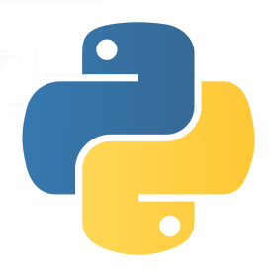

What is Boto? What Does it Do?
A Python library that provides “an integrated interface to infrastructural services offered by Amazon Web Services” like EC2, S3, EBS, and more.
Lets you script access to AWS resources in a Pythonic way.
Notes:
Install Apache, configure the vhost, and serve content from GitHub

Slide 6
Accessing AWS Objects

Slide 7
Configuring the Environment

Slide 8
Tips for Automating EC2 Objects

Slide 9
Case Study

Slide 10
Demo

Slide 11
BACKUP INFO

Slide 12
Links
https://boto.readthedocs.org/en/latest/

Slide 13
EC2 Tutorial https://boto.readthedocs.org/en/latest/ec2_tut.html
Launching Instances
Stopping Instances
Terminating Instances
Checking Health Status Of Instances
Using Elastic Block Storage (EBS)
Working With Snapshots

